Slide 1
Cumulative influence paper
Empirical case: reindeer space use
Base model: infrastructure + land_use +
(PCA1 + PCA1²) + (PCA2 + PCA2²) + PCA3 + PCA4
(all scaled)
Workflow for fitting
Infrastructure variables
Private cabins
Public cabins
Roads high
Roads low
Trails
Multivariate models:
Excluding correlated variables
Model comparison and inference based on the most parsimonious model
Selection of the ZoI: univariate models
Select best 15 ZoI for each variable

Slide 2
Cumulative influence paper
Empirical case: reindeer space use
Base model: infrastructure + land_use +
(PCA1 + PCA1²) + (PCA2 + PCA2²) + PCA3 + PCA4
(all scaled)
Workflow for fitting
Infrastructure variables
Private cabins
Public cabins
Roads high
Roads low
Trails
Multivariate models:
Excluding correlated variables
Model comparison and inference based on the most parsimonious model
Selection of the ZoI: univariate models
Select best 5 ZoI for each variable
Variables nearest
Log dist
Threshold of correlation = 0.7

Slide 3
ank Private cabins Public cabins high AIC dAIC wAIC
1 cumulative, threshold, 10 cumulative, exp decay, 20 147578 0 1
2 cumulative, Gauss, 10 cumulative, exp decay, 20 147610 31.9 <0.001
3 cumulative, exp decay, 10 cumulative, exp decay, 20 147634 55.2 <0.001
4 cumulative, bartlett, 10 cumulative, exp decay, 20 147667 88.3 <0.001
5 cumulative, threshold, 10 cumulative, Gauss, 20 147702 123.1 <0.001
28 cumulative, exp decay, 10 nearest, bartlett, 20 148363 784.7 <0.001

Slide 4
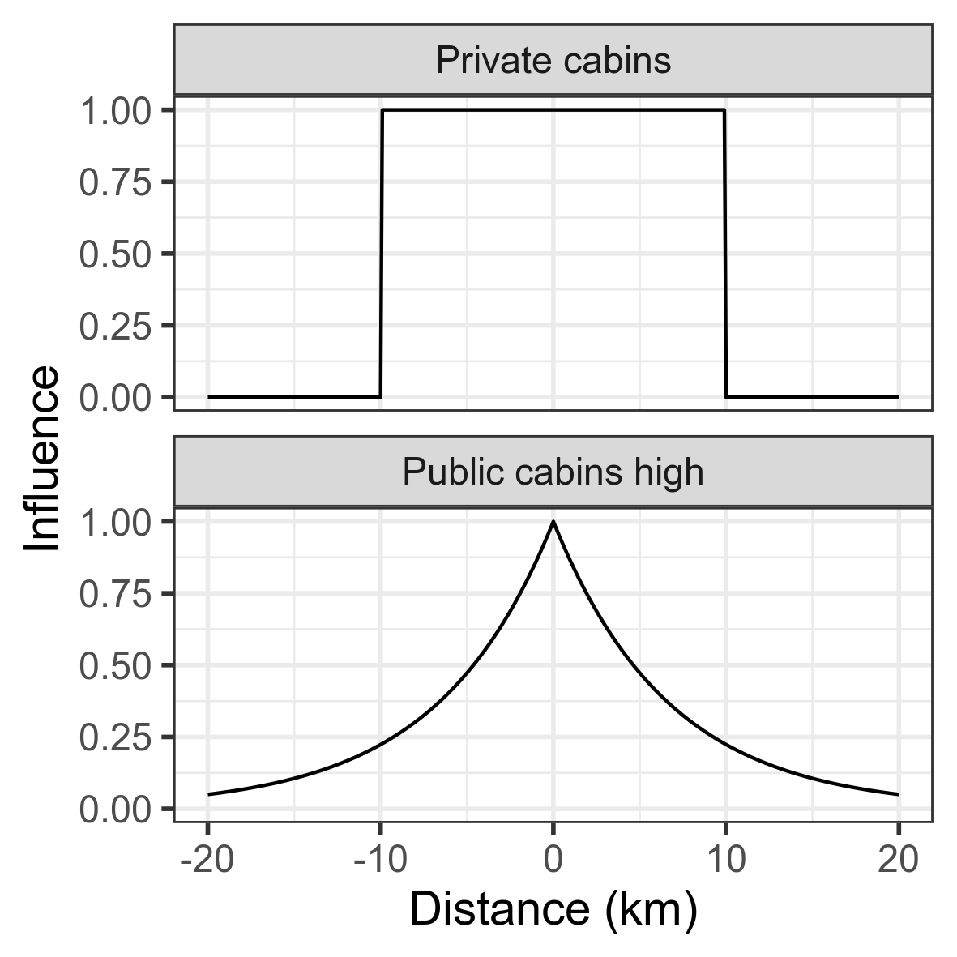
Influence function

Slide 5
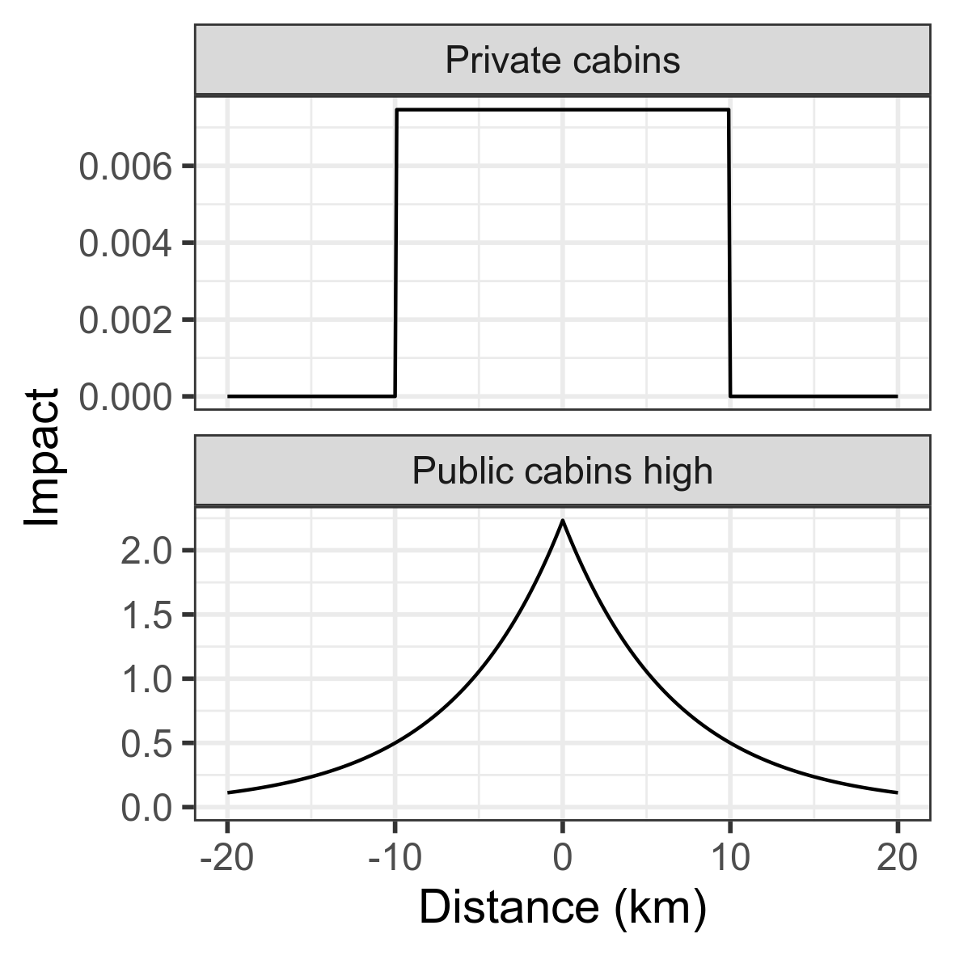
Impact = -1 * coefficient * variable
Influence function
Impact = -1 * coefficient * (1 feature)

Slide 6
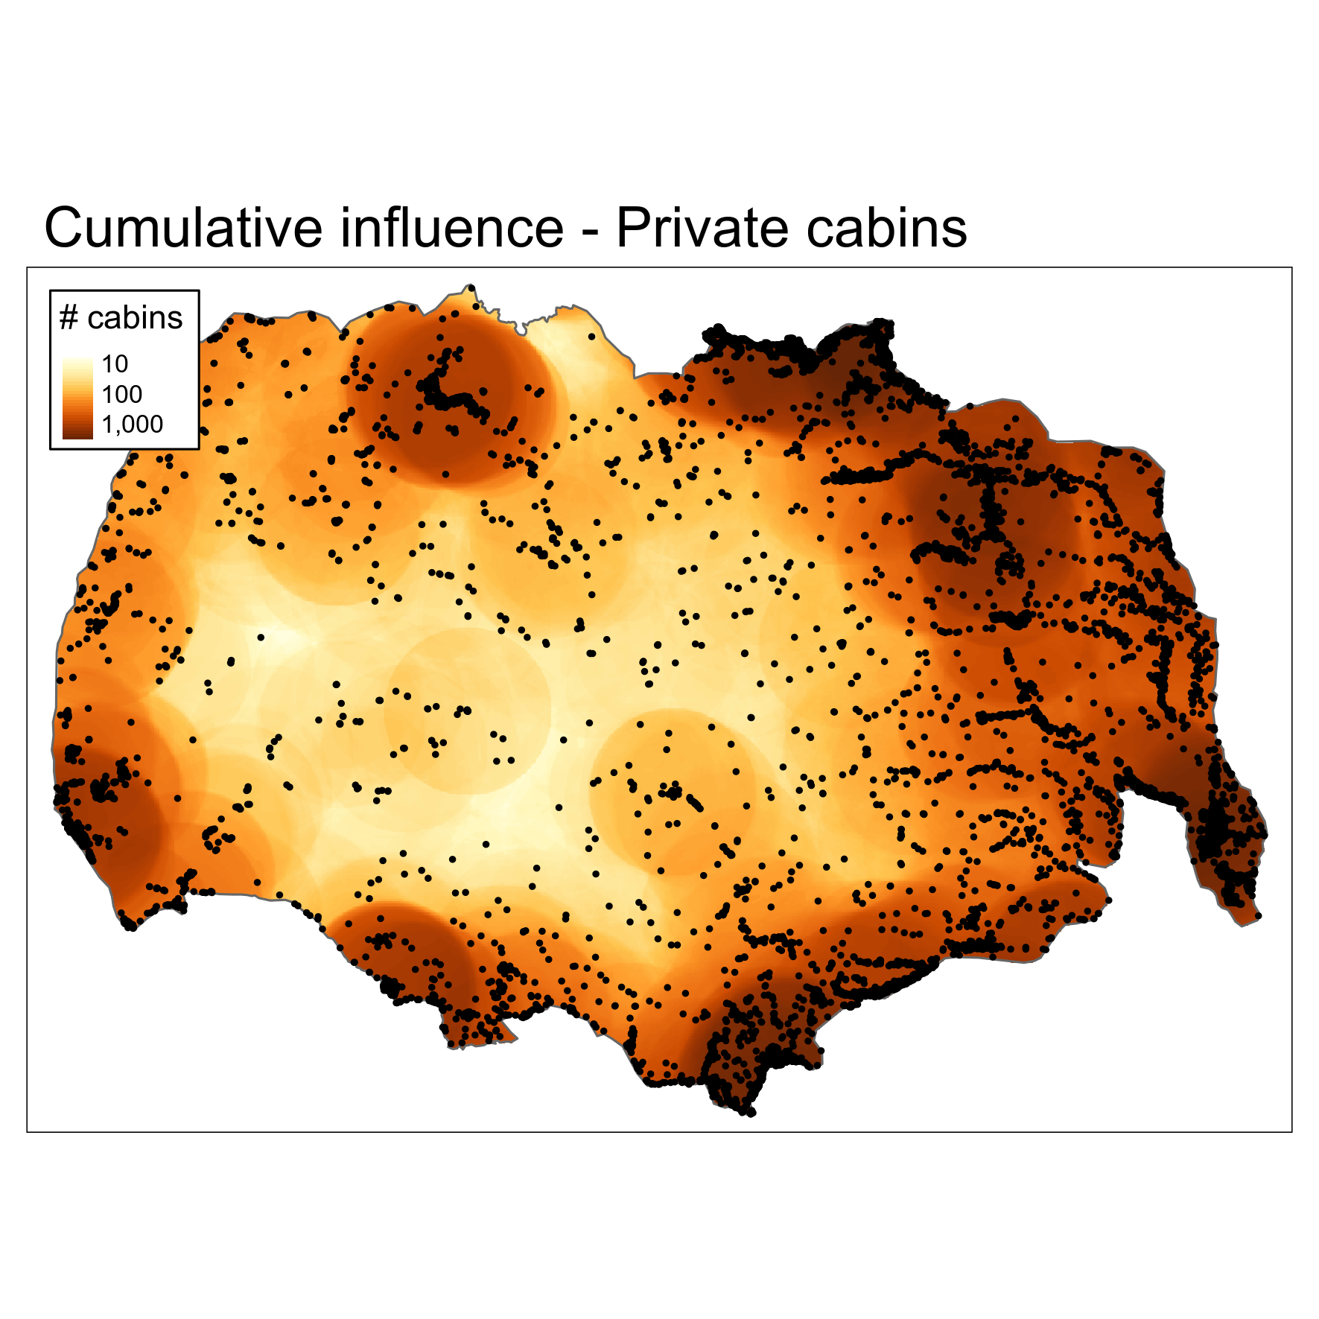
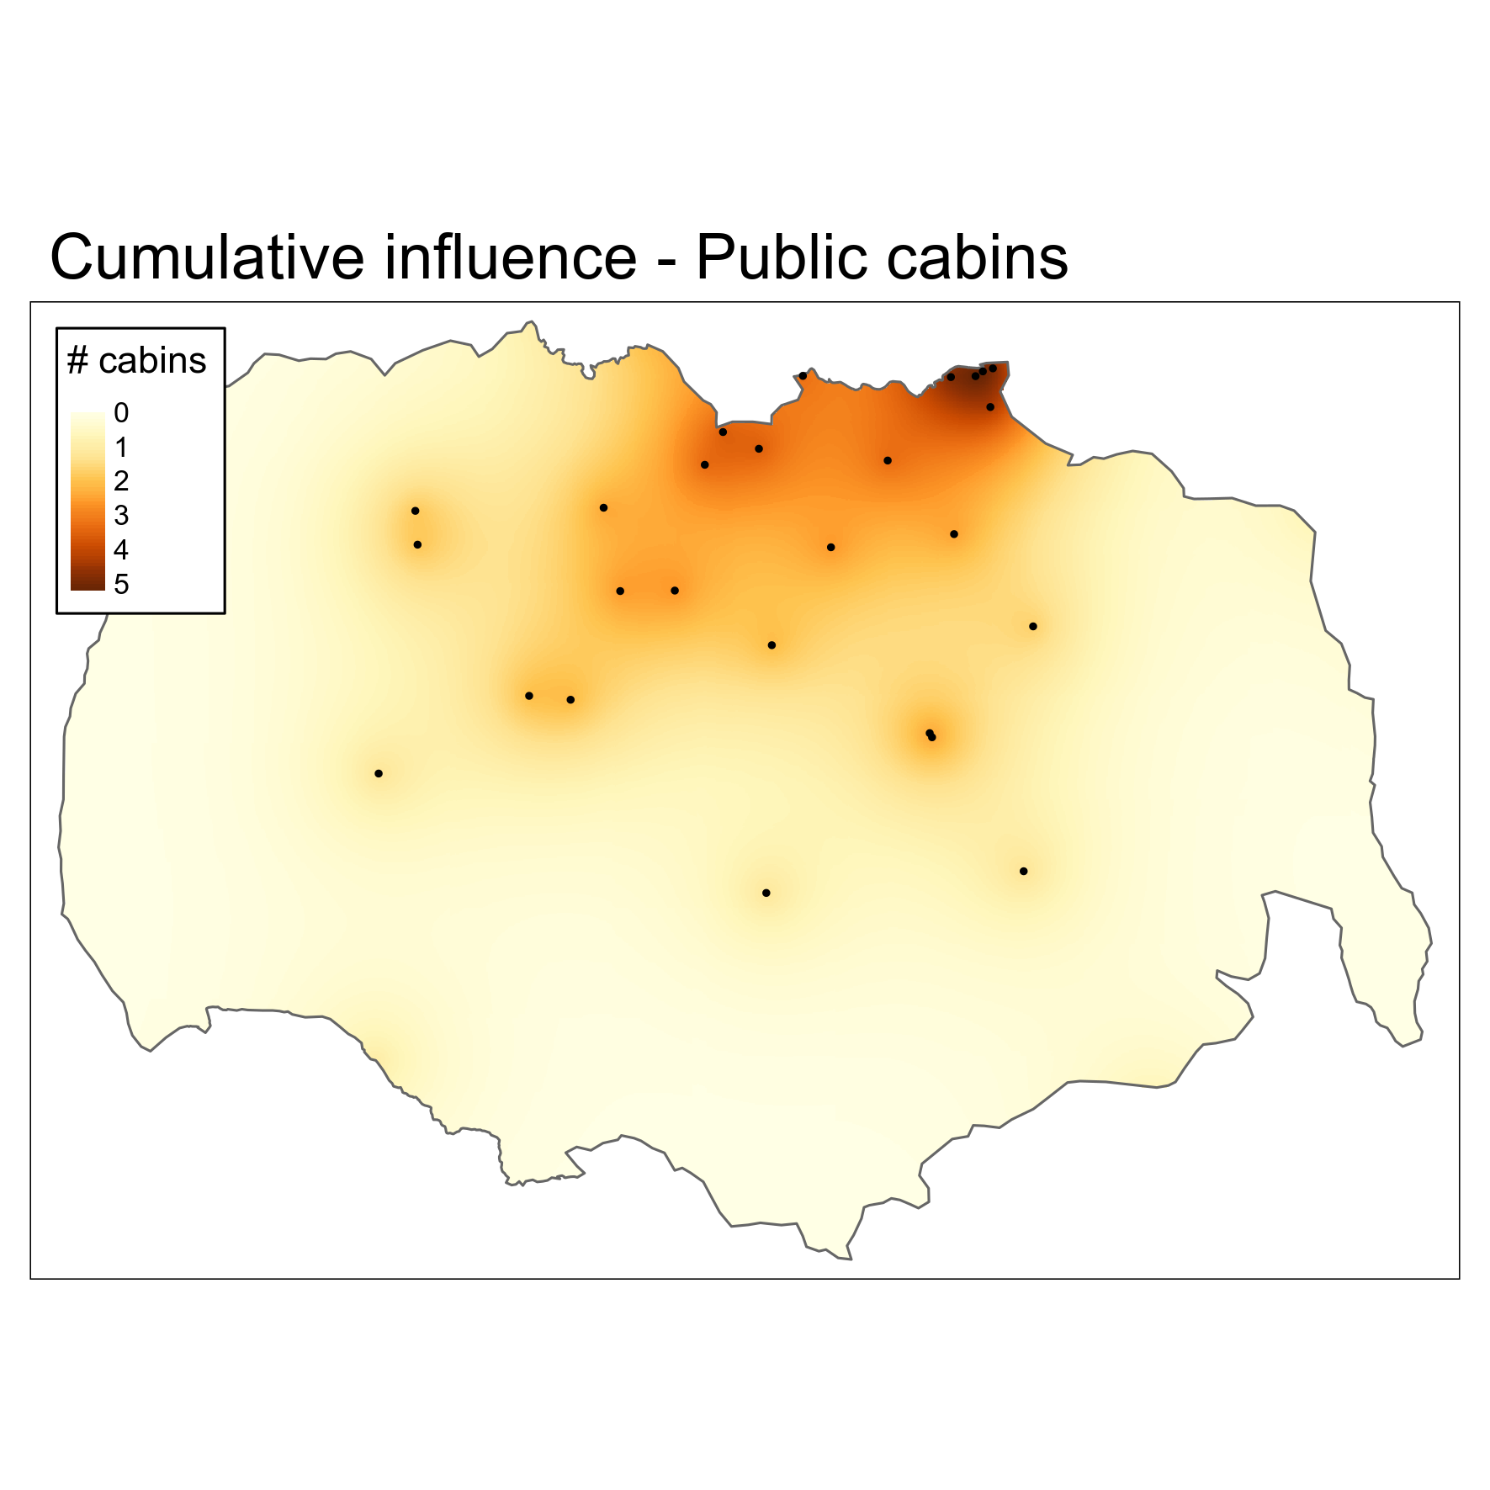
Impact = -1 * coefficient * (1 feature)

Slide 7
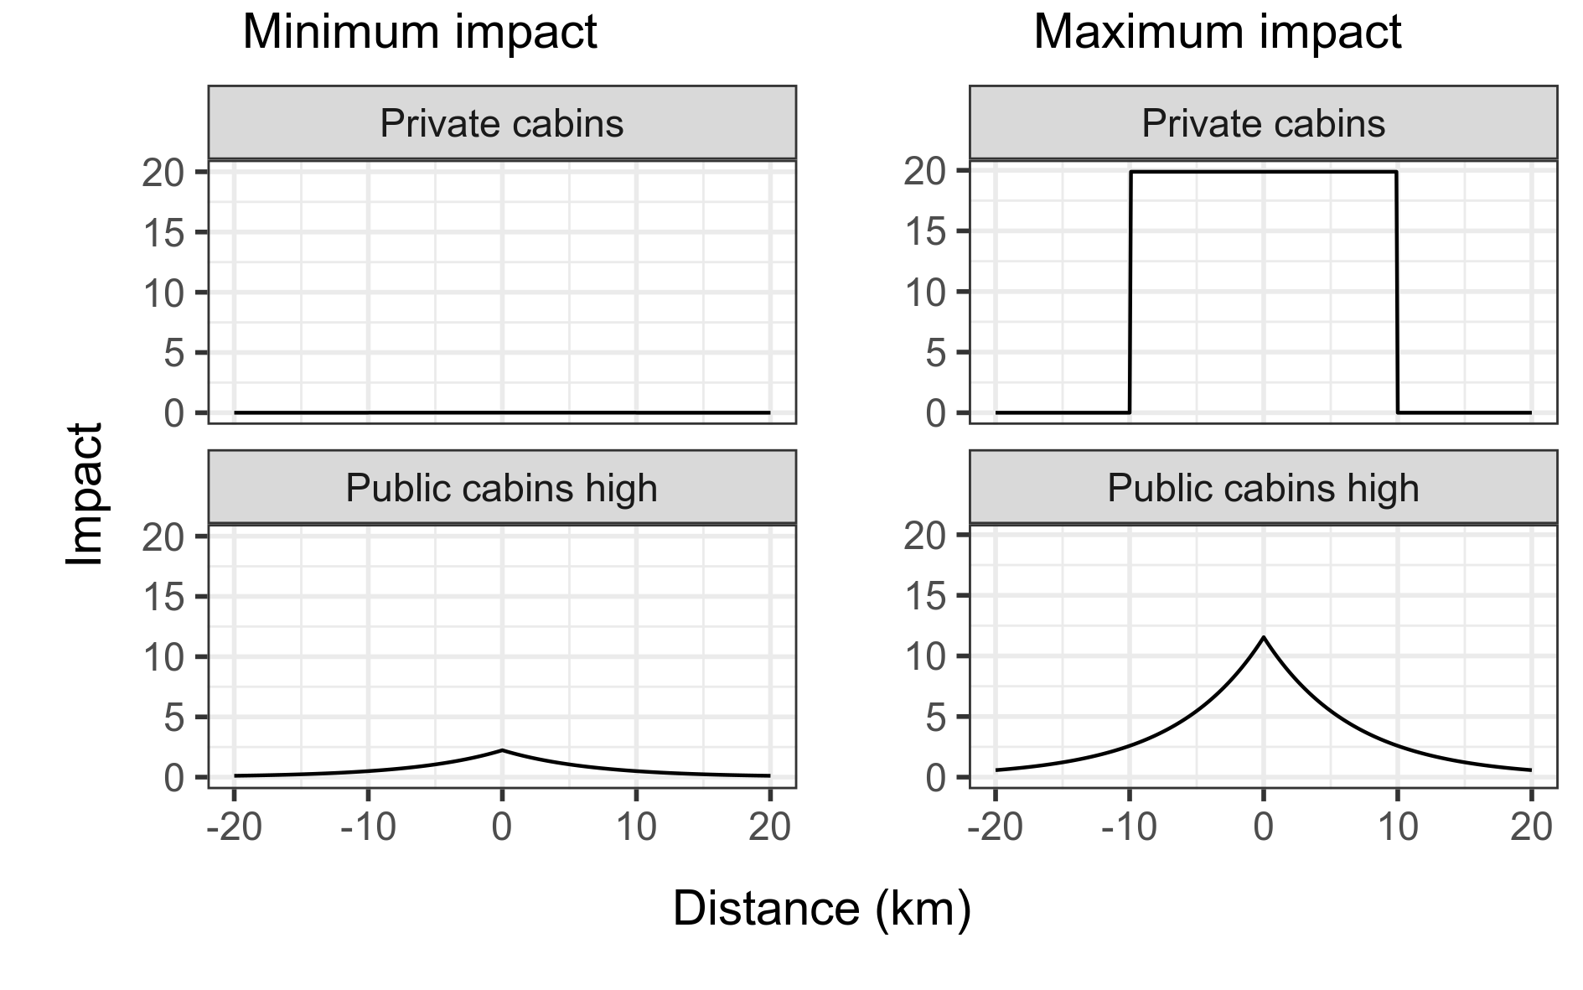

Slide 8
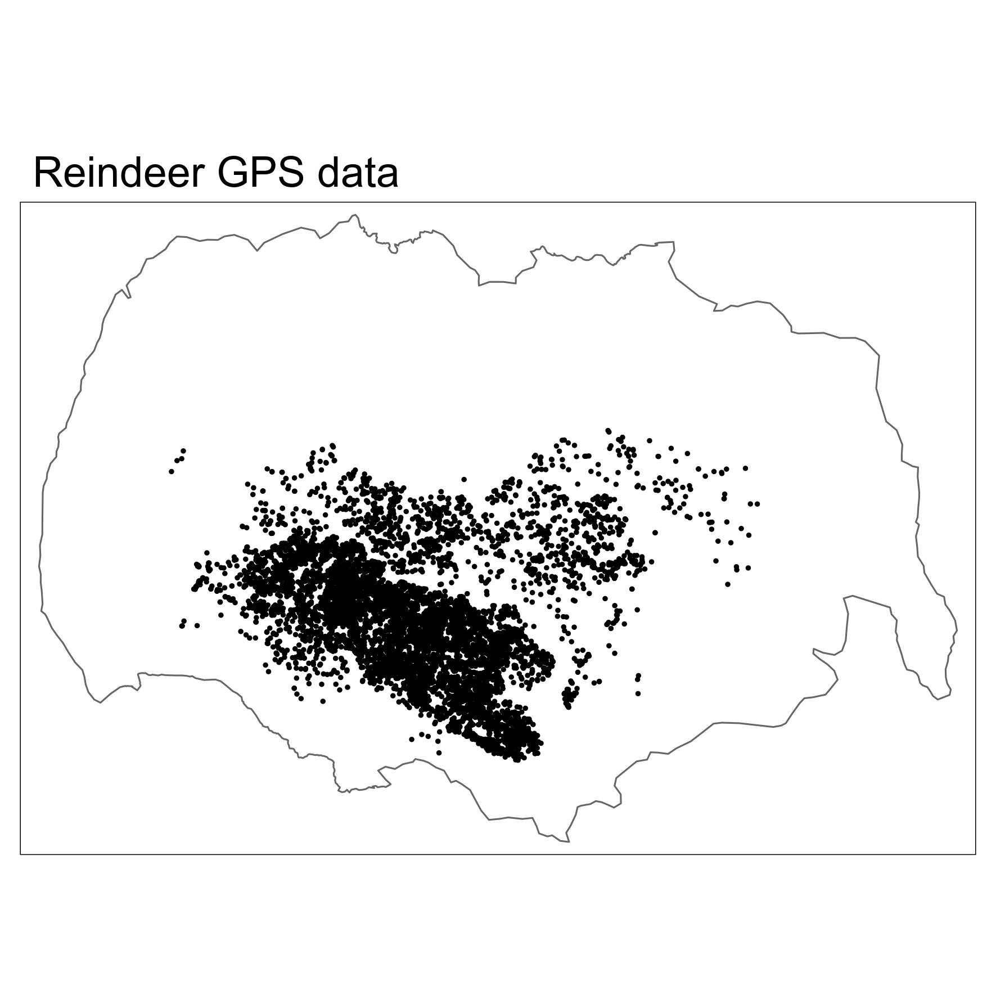
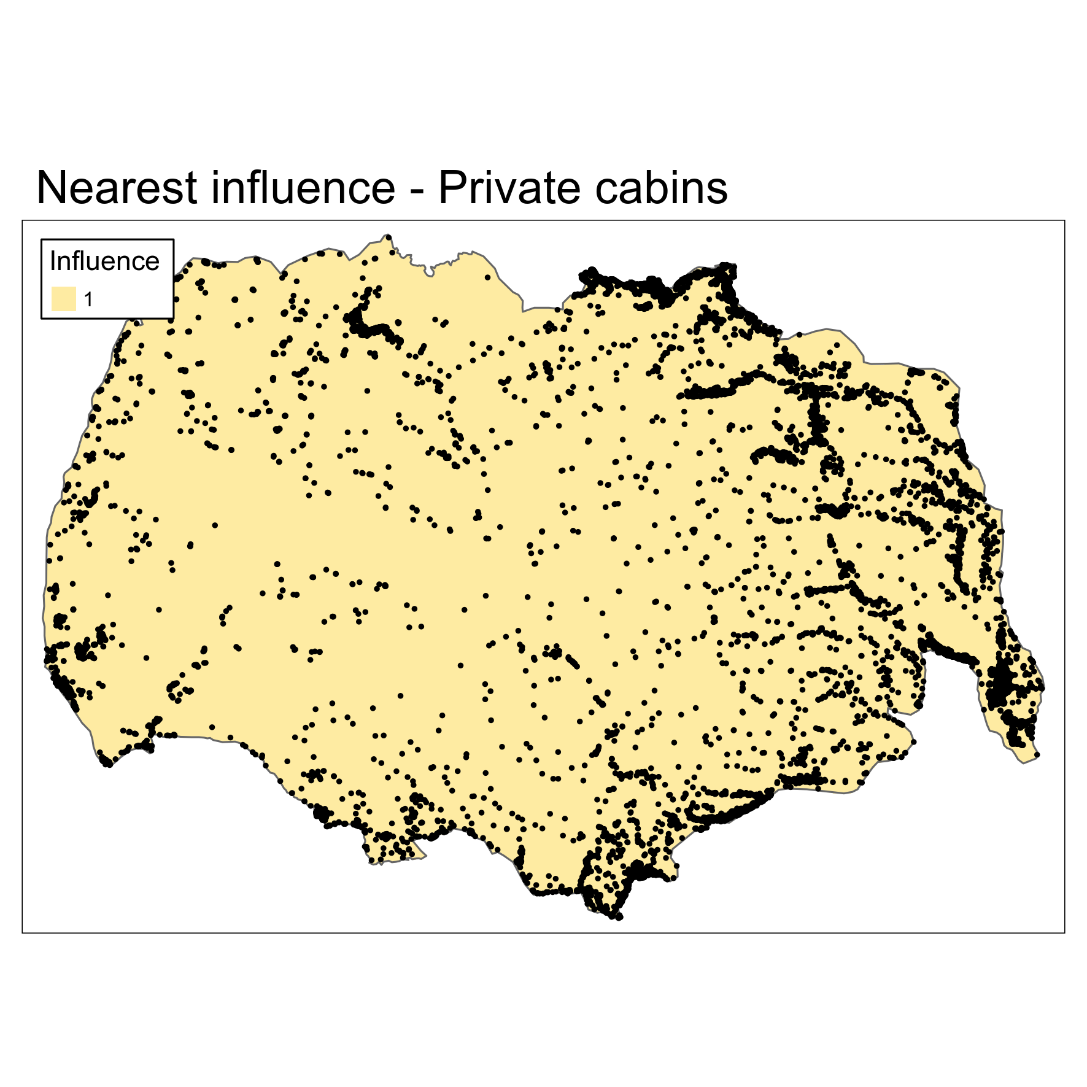
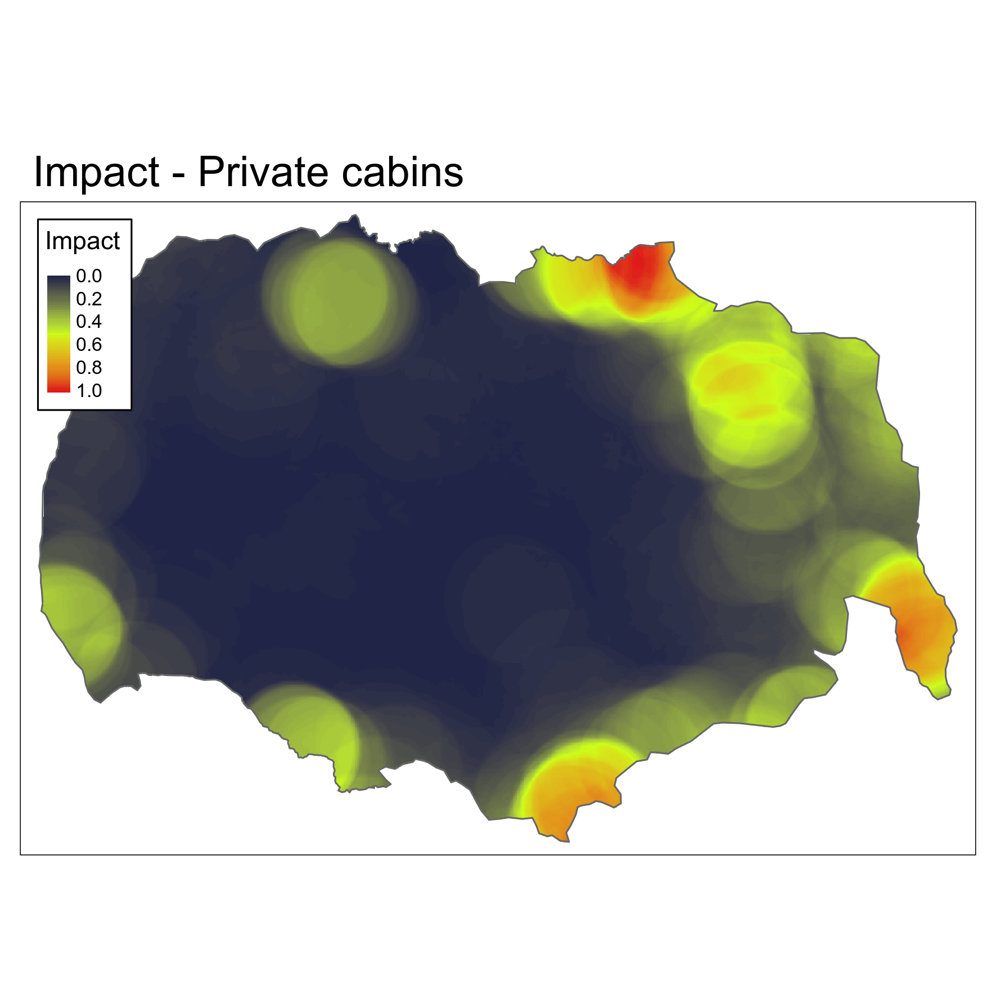
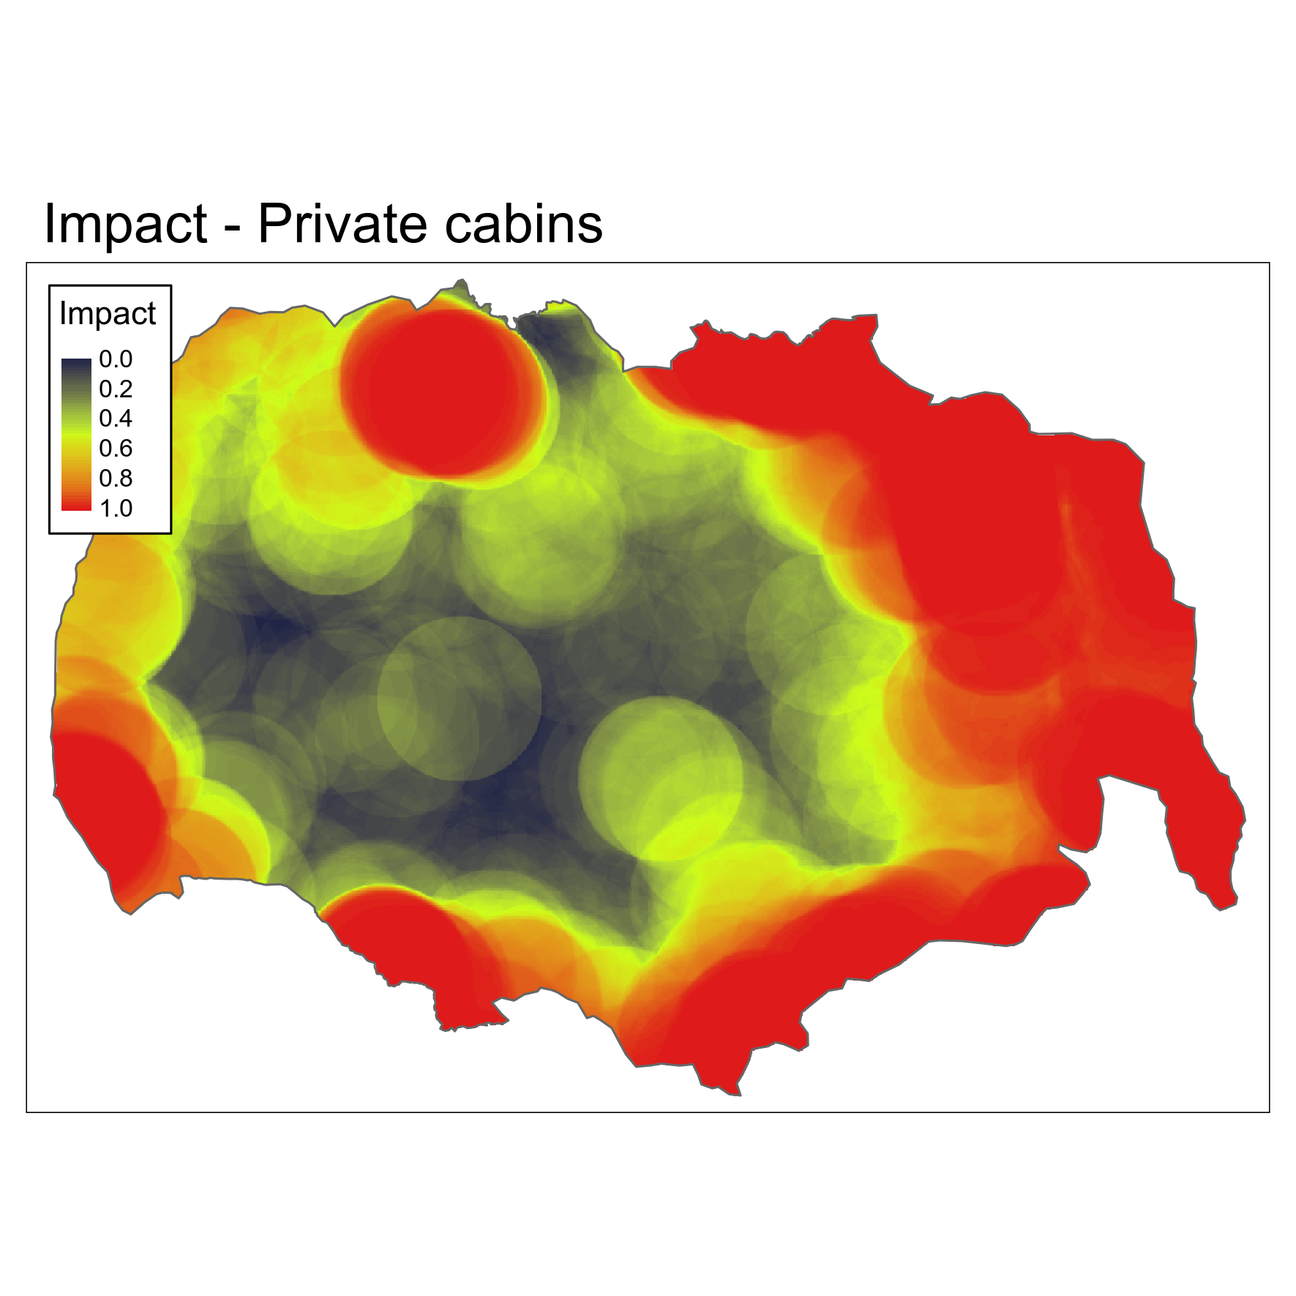

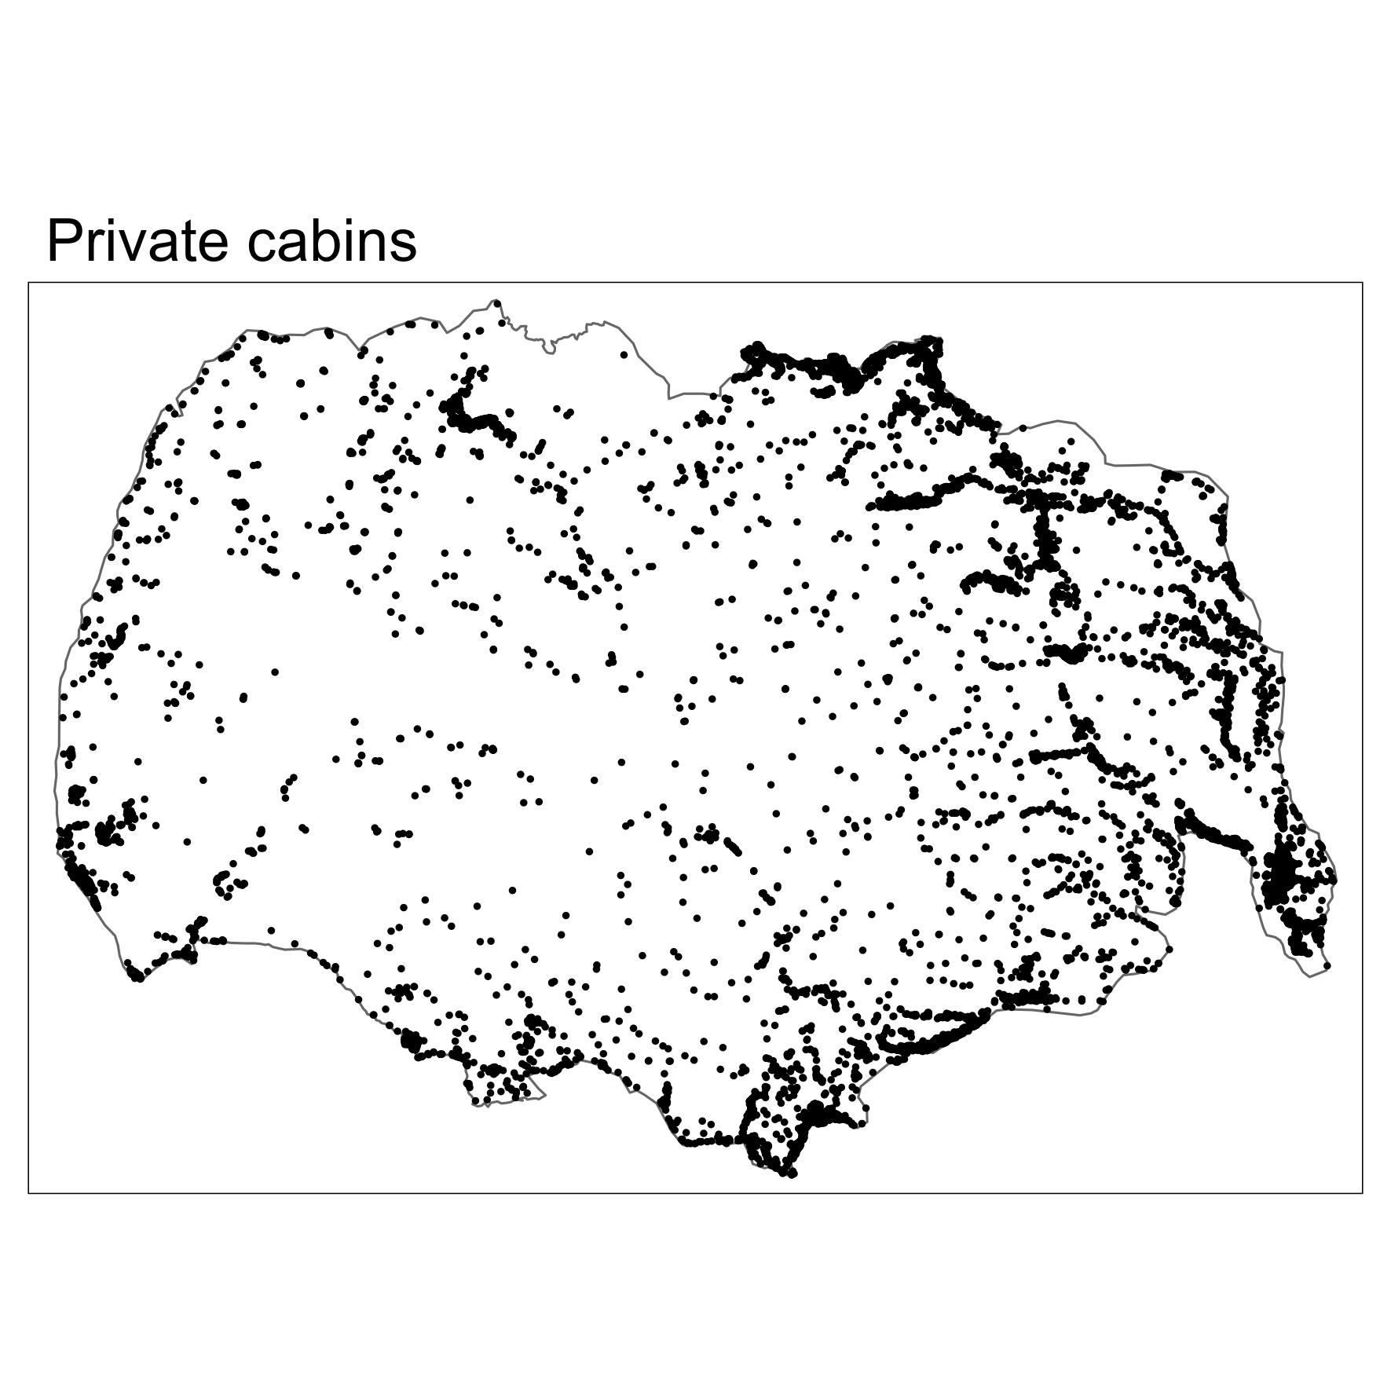
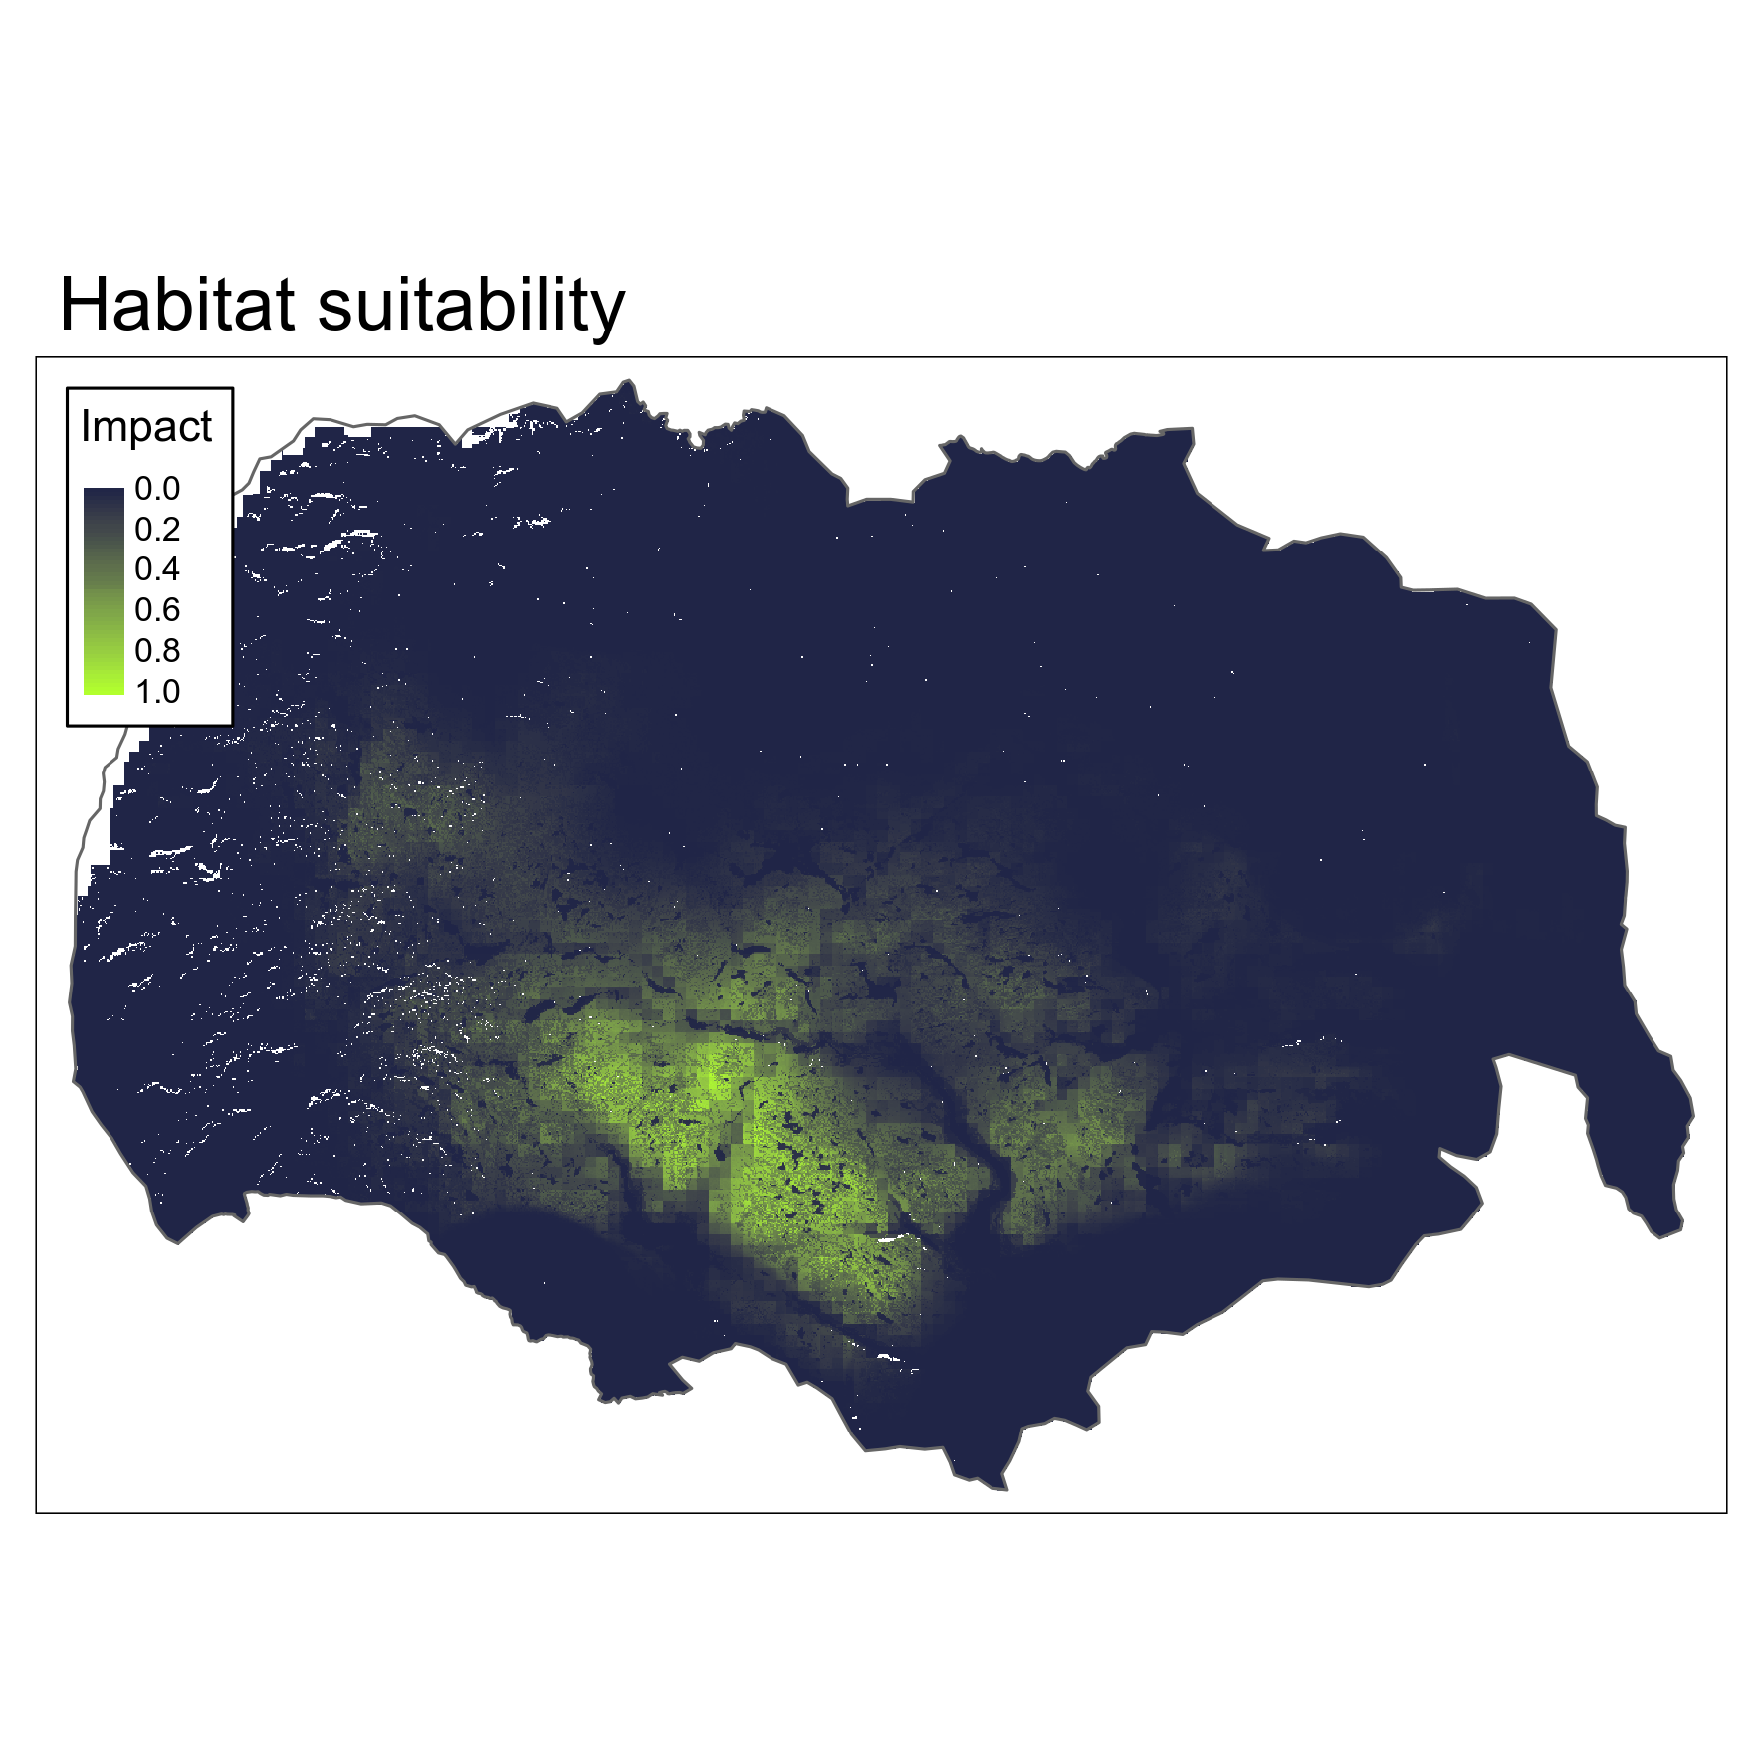

Slide 9
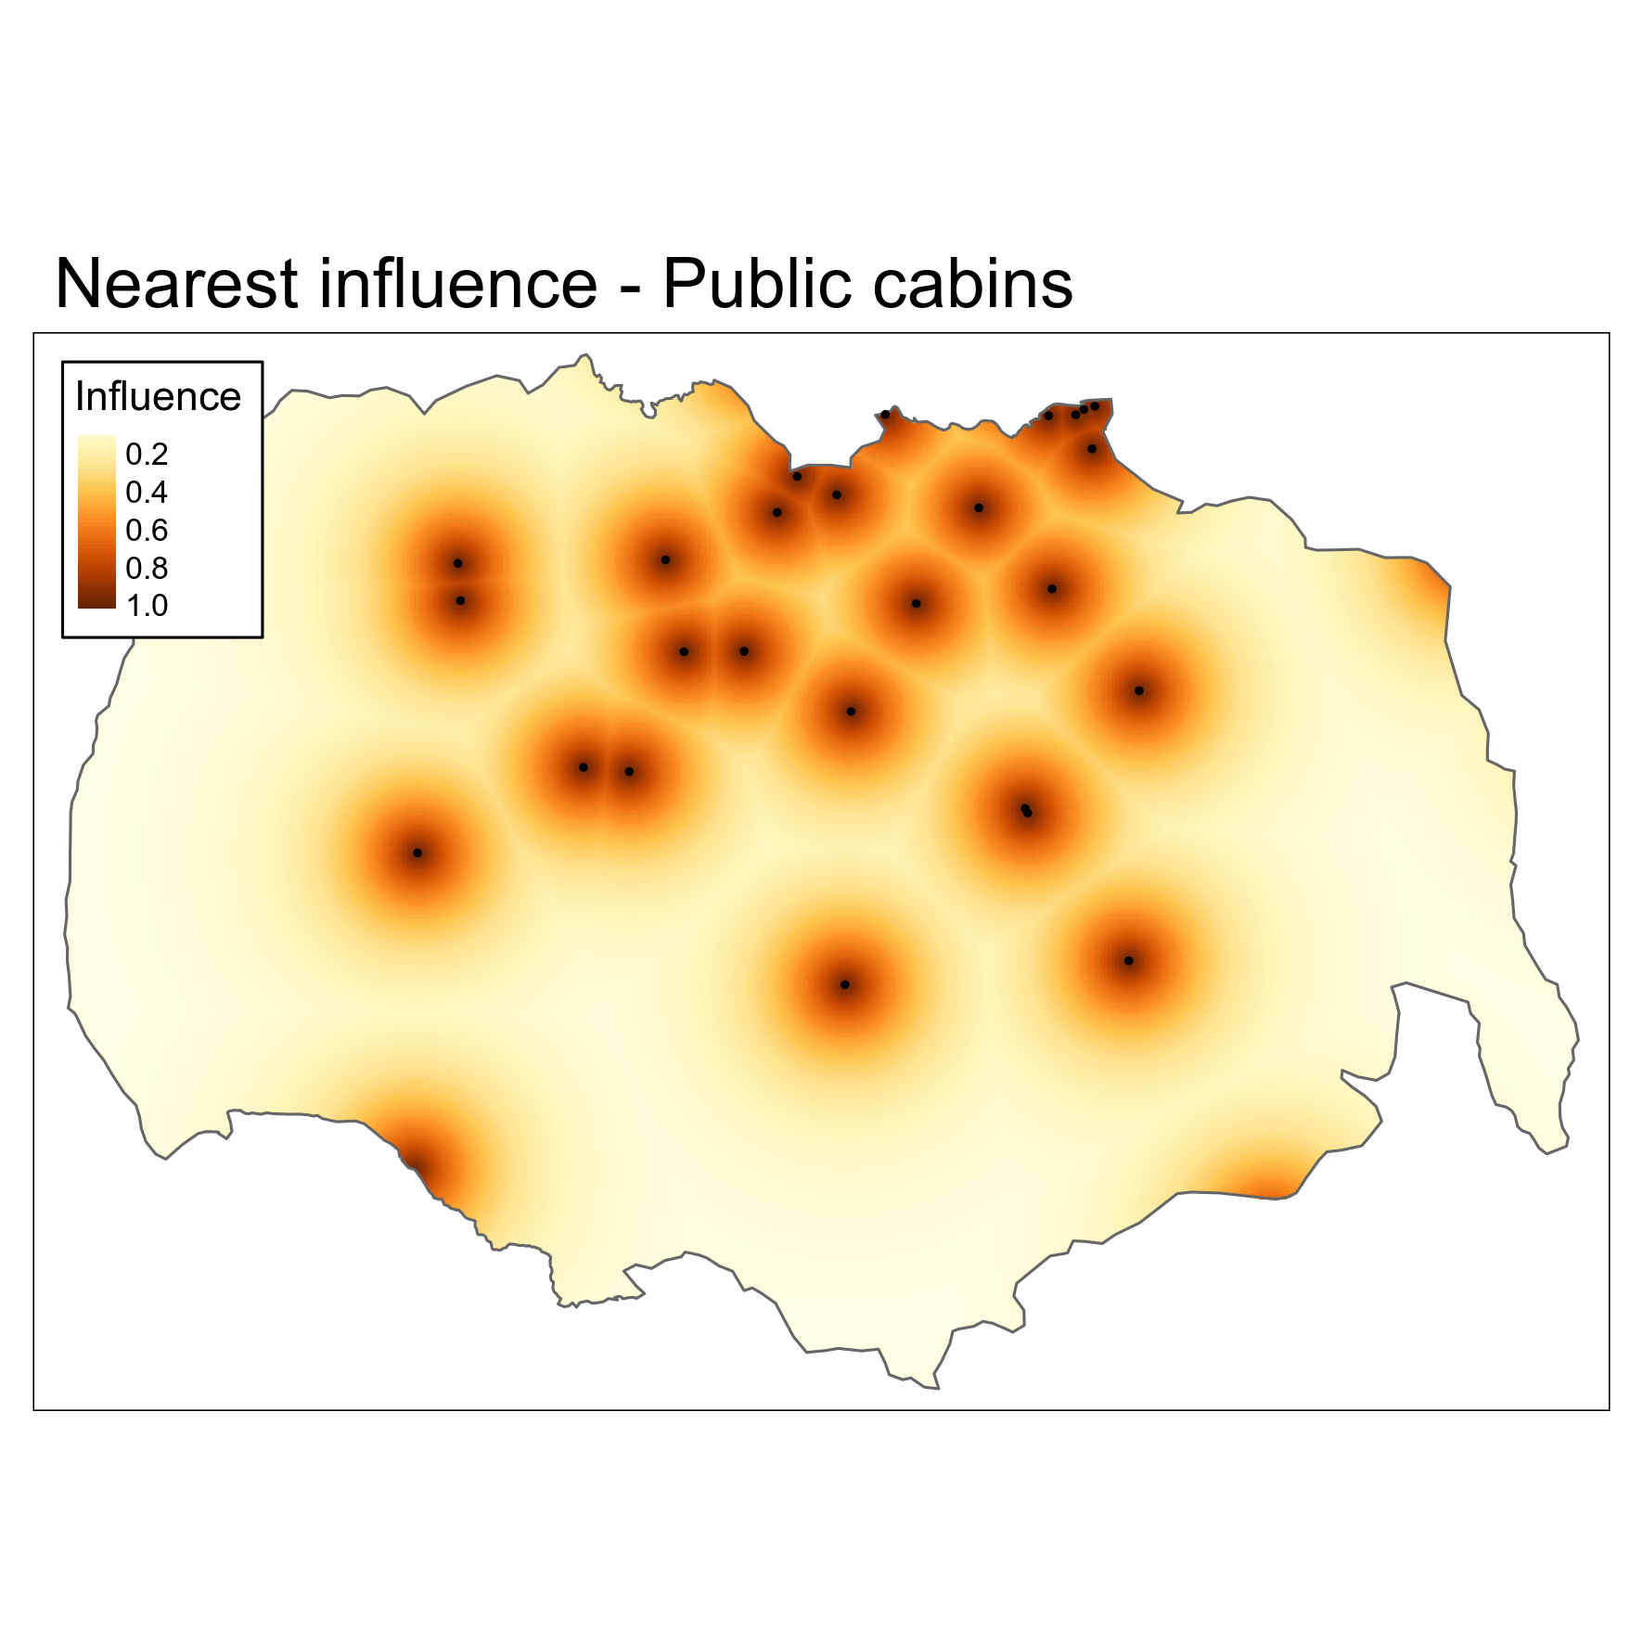
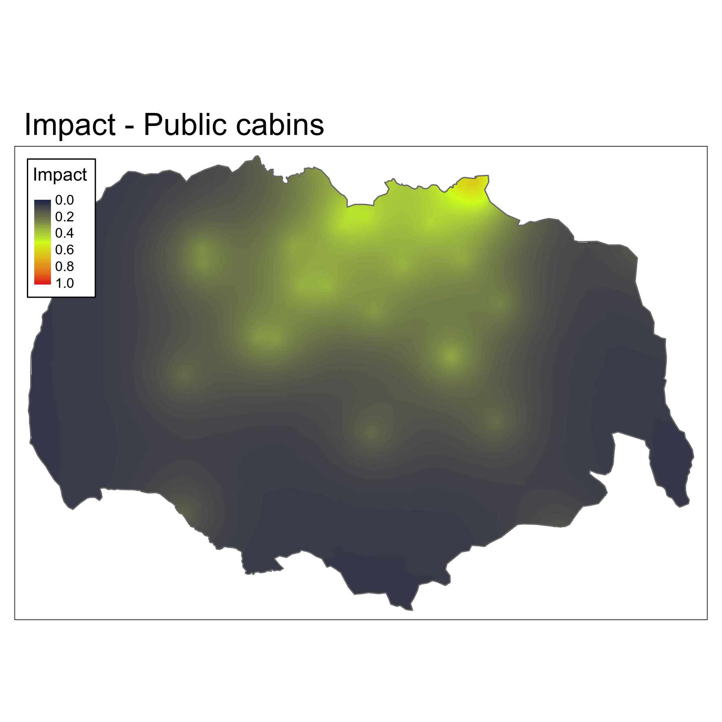
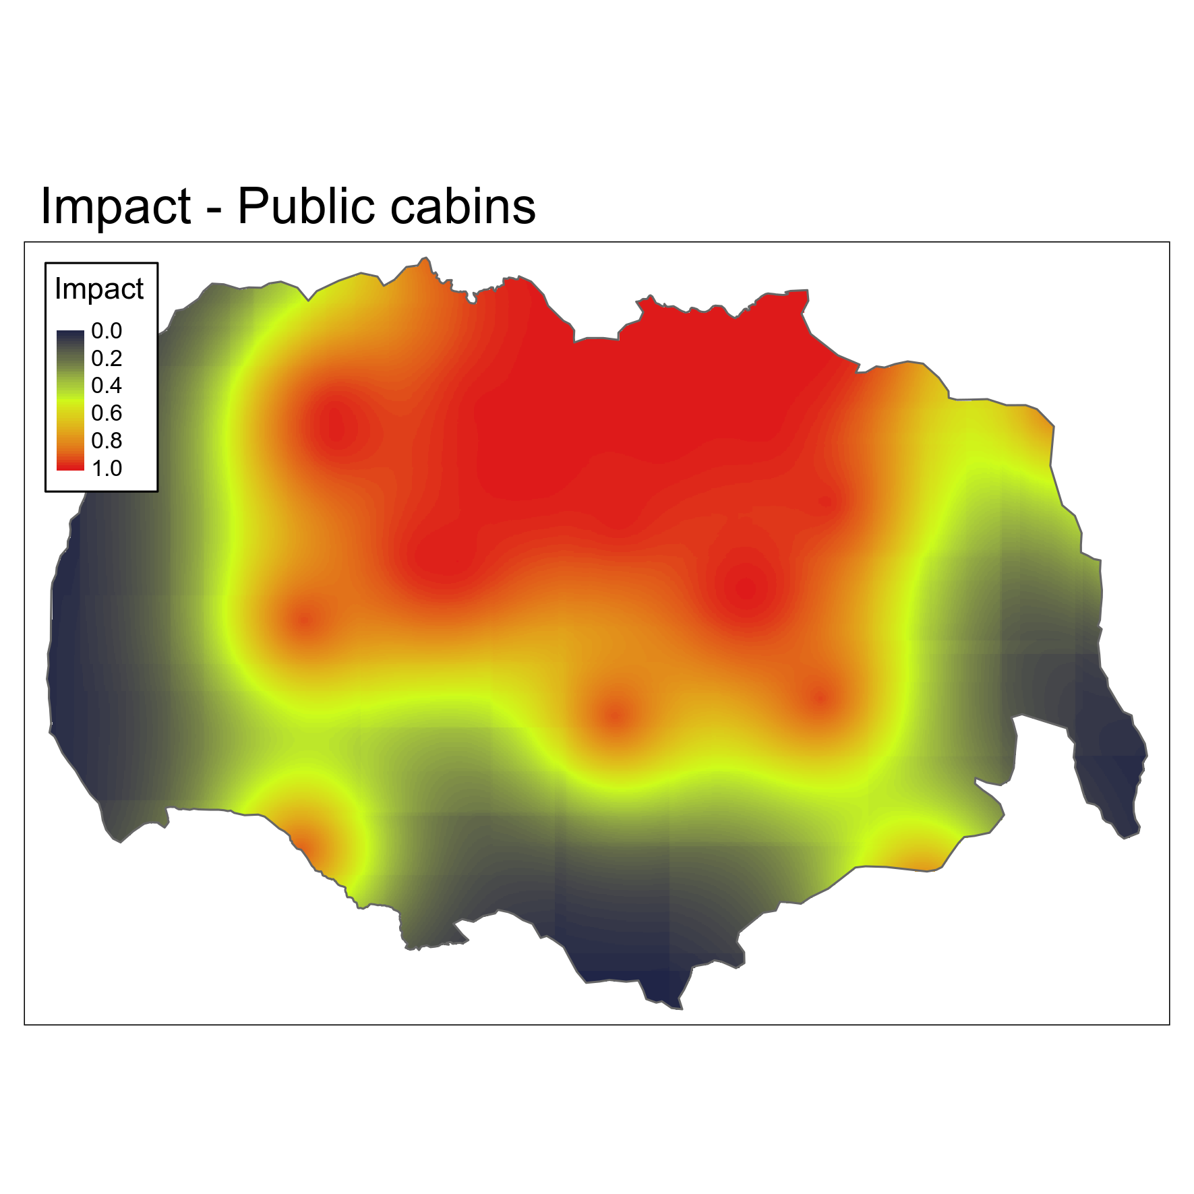
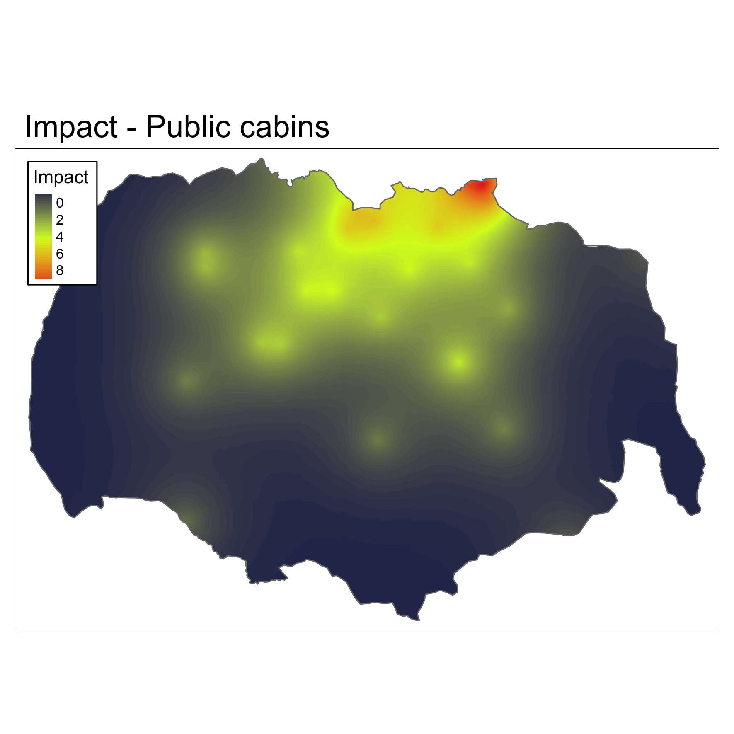
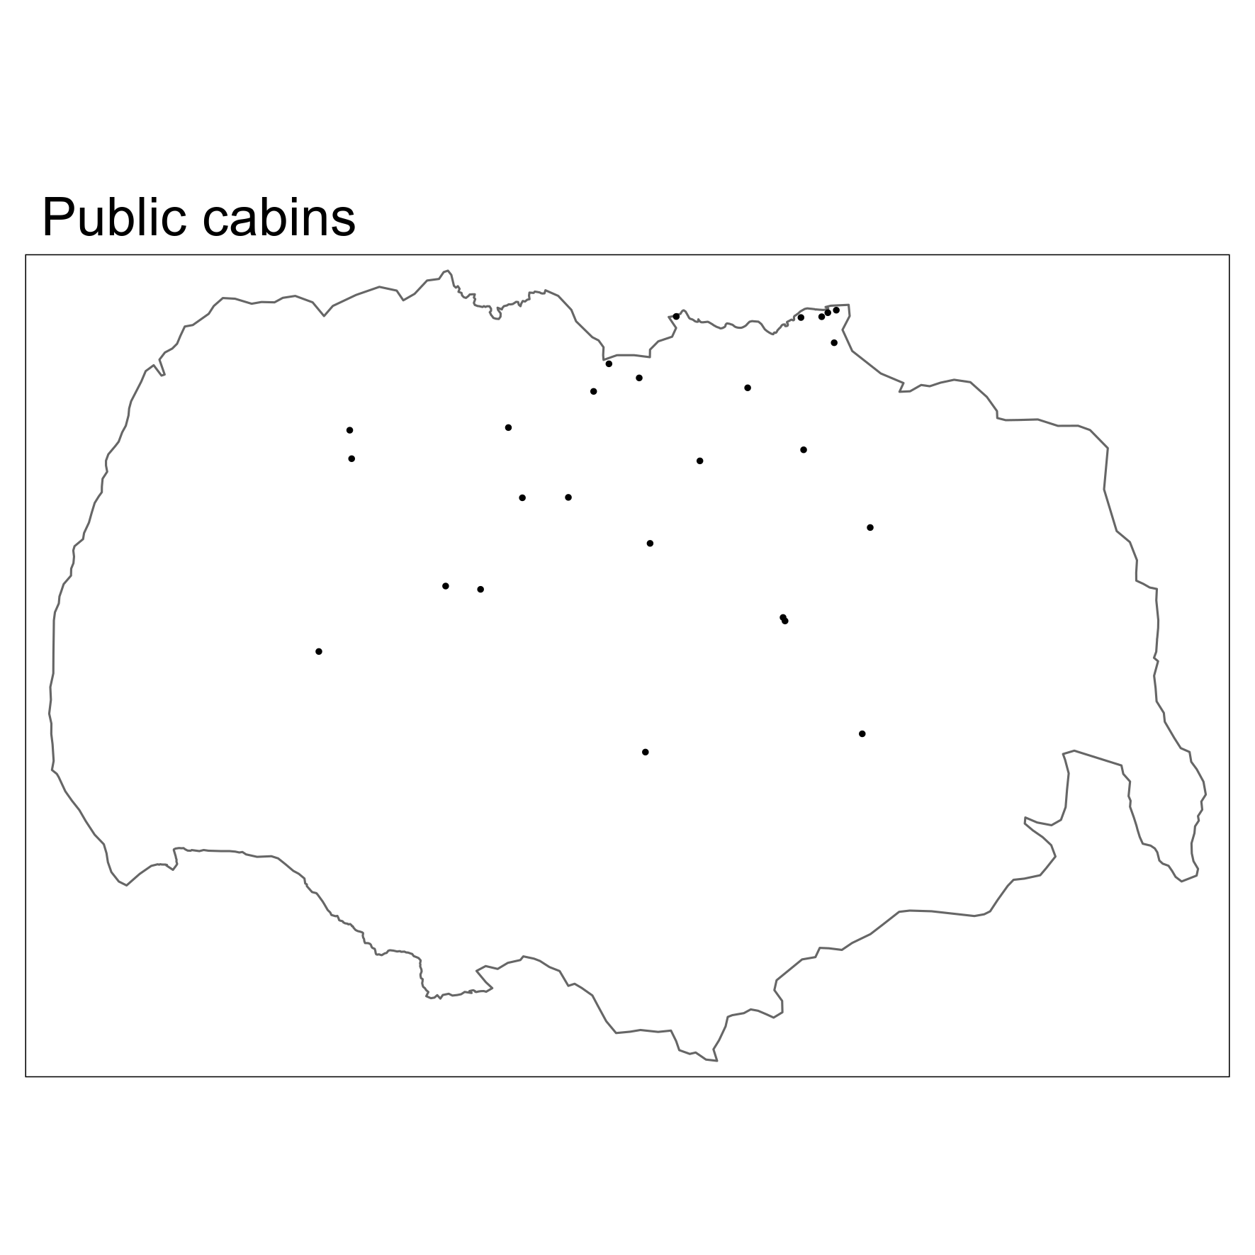

Slide 11
Impact = -1 * coefficient * variable

Slide 12

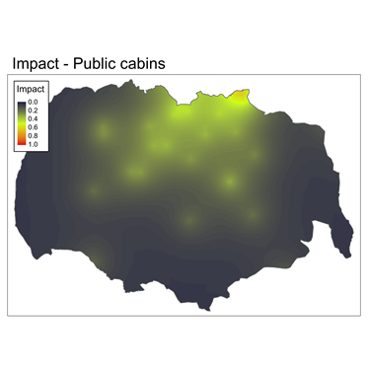
Impact = -1 * coefficient * variable
(Scaled to [0-1] with the same maximum)

Slide 13


Impact = 1 – rescale(exp(coefficient * variable))

